Slide 1

CREDIT EDA ASSIGNMENT
BY-
APOORVA NEDUNOORI
(APFE22m00993)

Slide 2
PROBLEM STATEMENT
The loan providing companies find it hard to give loans to the people due to their insufficient or non-existent credit history.
Because of that, some consumers use it to their advantage by becoming a defaulter. Suppose you work for a consumer finance company which specializes in lending various types of loans to urban customers.
You have to use EDA to analyze the patterns present in the data. This will ensure that the applicants capable of repaying the loan are not rejected.

Slide 3
BUSINESS UNDERSTANDING
When the company receives a loan application, the company has to decide for loan approval based on the applicant’s profile. Two types of risks are associated with the bank’s decision:
If the applicant is likely to repay the loan, then not approving the loan results in a loss of business to the company
If the applicant is not likely to repay the loan, i.e. he/she is likely to default, then approving the loan may lead to a financial loss for the company.

Slide 4
BUSINESS UNDERSTANDING
The data given , contains the information about the loan application at the time of applying for the loan. It contains two types of scenarios:
The client with payment difficulties: he/she had late payment more than X days on at least one of the first Y instalments of the loan in our sample,
All other cases: All other cases when the payment is paid on time.
When a client applies for a loan, there are four types of decisions that could be taken by the client/company):
Approved: The Company has approved loan Application
Cancelled: The client cancelled the application sometime during approval. Either the client changed her/his mind about the loan or in some cases due to a higher risk of the client, he received worse pricing which he did not want.
Refused: The company had rejected the loan (because the client does not meet their requirements etc.).
Unused offer: Loan has been cancelled by the client but at different stages of the process.
In this case study, we use EDA to understand how consumer attributes and loan attributes influence the tendency to default.

Slide 5
Business Objectives
This case study aims to identify patterns which indicate if a client has difficulty paying their instalments which may be used for taking actions such as denying the loan, reducing the amount of loan, lending (to risky applicants) at a higher interest rate, etc.
This will ensure that the consumers capable of repaying the loan are not rejected. Identification of such applicants using EDA is the aim of this case study.
In other words, the company wants to understand the driving factors (or driver variables) behind loan default, i.e. the variables which are strong indicators of default.
The company can utilize this knowledge for its portfolio and risk assessment.

Slide 6
Dataset Given:
The given dataset has 3 files as explained below:
1. 'application_data.csv' contains all the information of the client at the time of application. The data is about whether a client has payment difficulties.
2. 'previous_application.csv' contains information about the client’s previous loan data. It contains the data on whether the previous application had been Approved, Cancelled, Refused or Unused offer.
3. 'columns_description.csv' is data dictionary which describes the meaning of the variables.

Slide 7
Application_data Analysis
”TARGET” column gives us the information if the client is a defaulter or not.
“TARGET”, 1 implies a defaulter, 0 is a non-defaulter
The shape of the dataset is 307511,122
There are many different types of datatypes like object, int, float present in the dataset.

Slide 8
Application_data Analysis
The columns greater than 45% of missing values are dropped.
The median is added to impute the missing values in the existing columns.
Outliers are identified and treated.
Converted negative values present in “date” columns into positive numbers.

Slide 9
Application_data Analysis
Filtered Categorical, Quantitative values on ”obj”,”Int”,”Float” datatypes.
Merged the “SK_ID_CURR” column using pivot table as it is present in both the datasets.
The total count of missing values in the rows are also shown in the notebook.

Slide 10
Application_data Analysis
Binning is done on “AMT_INCOME_TOTAL”, “AMT_CREDIT” using Histogram.
Univariate analysis is done on the application_data dataset.
Bivariate analysis is also done on the application_data dataset.
Correlation on the TARGET variables are shown using HEATMAPS.

Slide 11
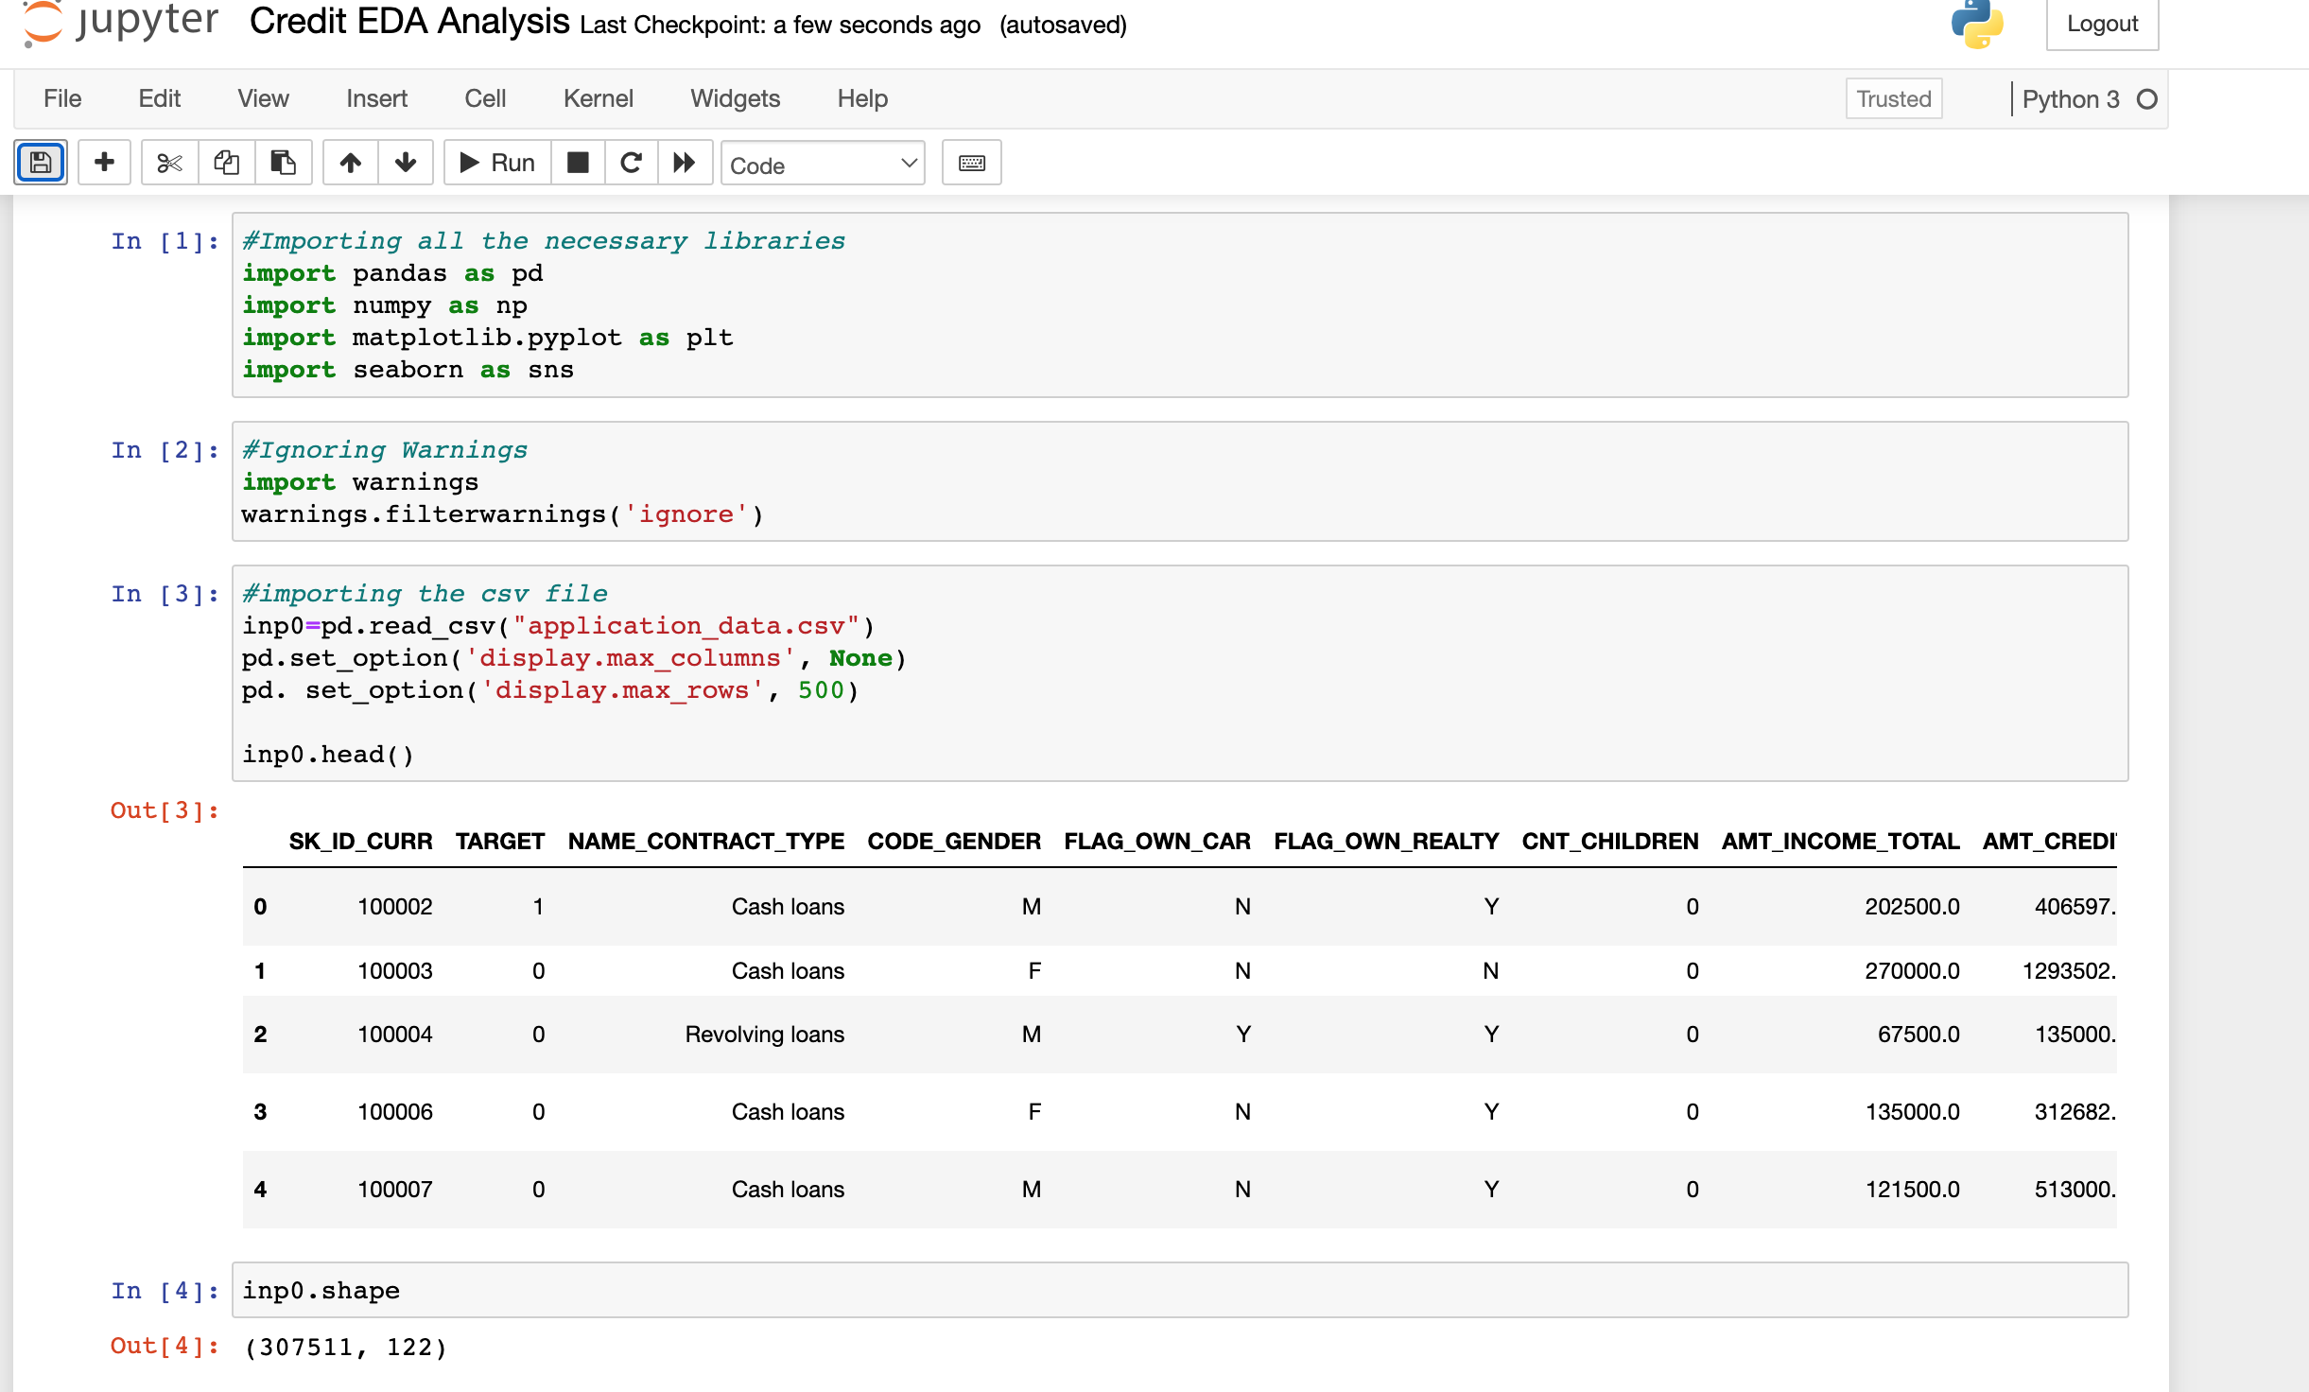
Application_data Analysis
Importing the necessary libraries and csv files

Slide 12
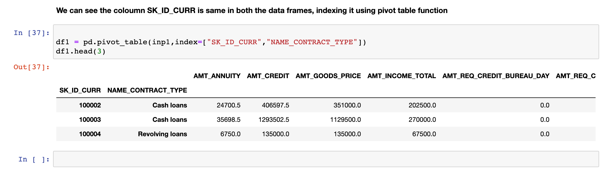
Merging the data on SK_ID_CURR column

Slide 13
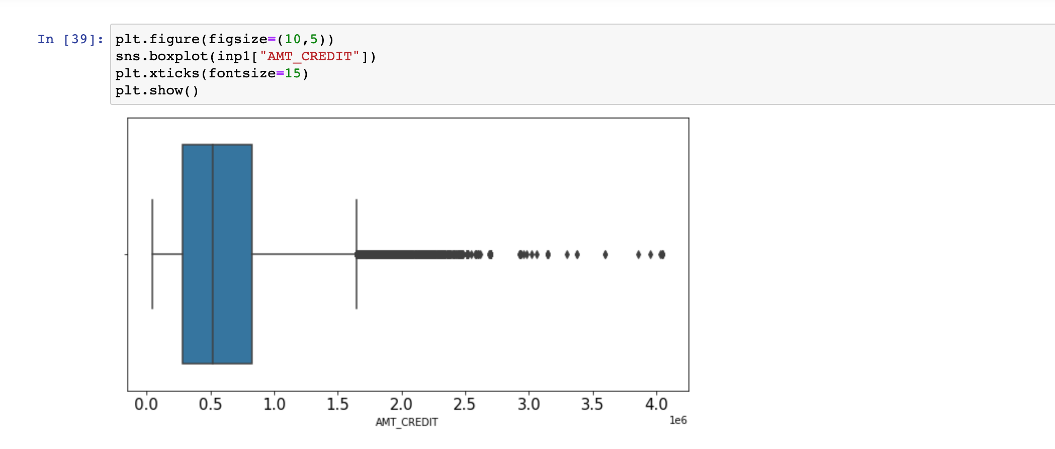
Checking for OUTLIERS in AMT_CREDIT column

Slide 14
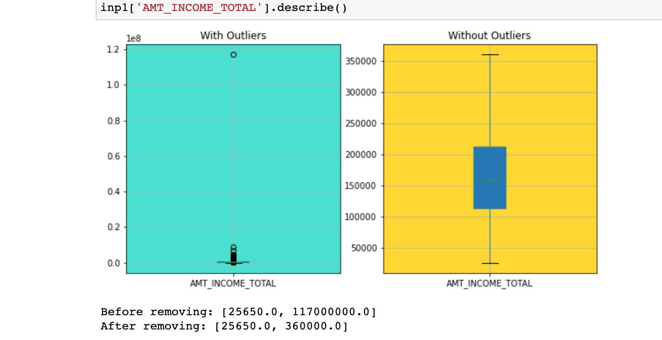
Treatment of Outliers in AMT_INCOME_TOTAL column

Slide 15
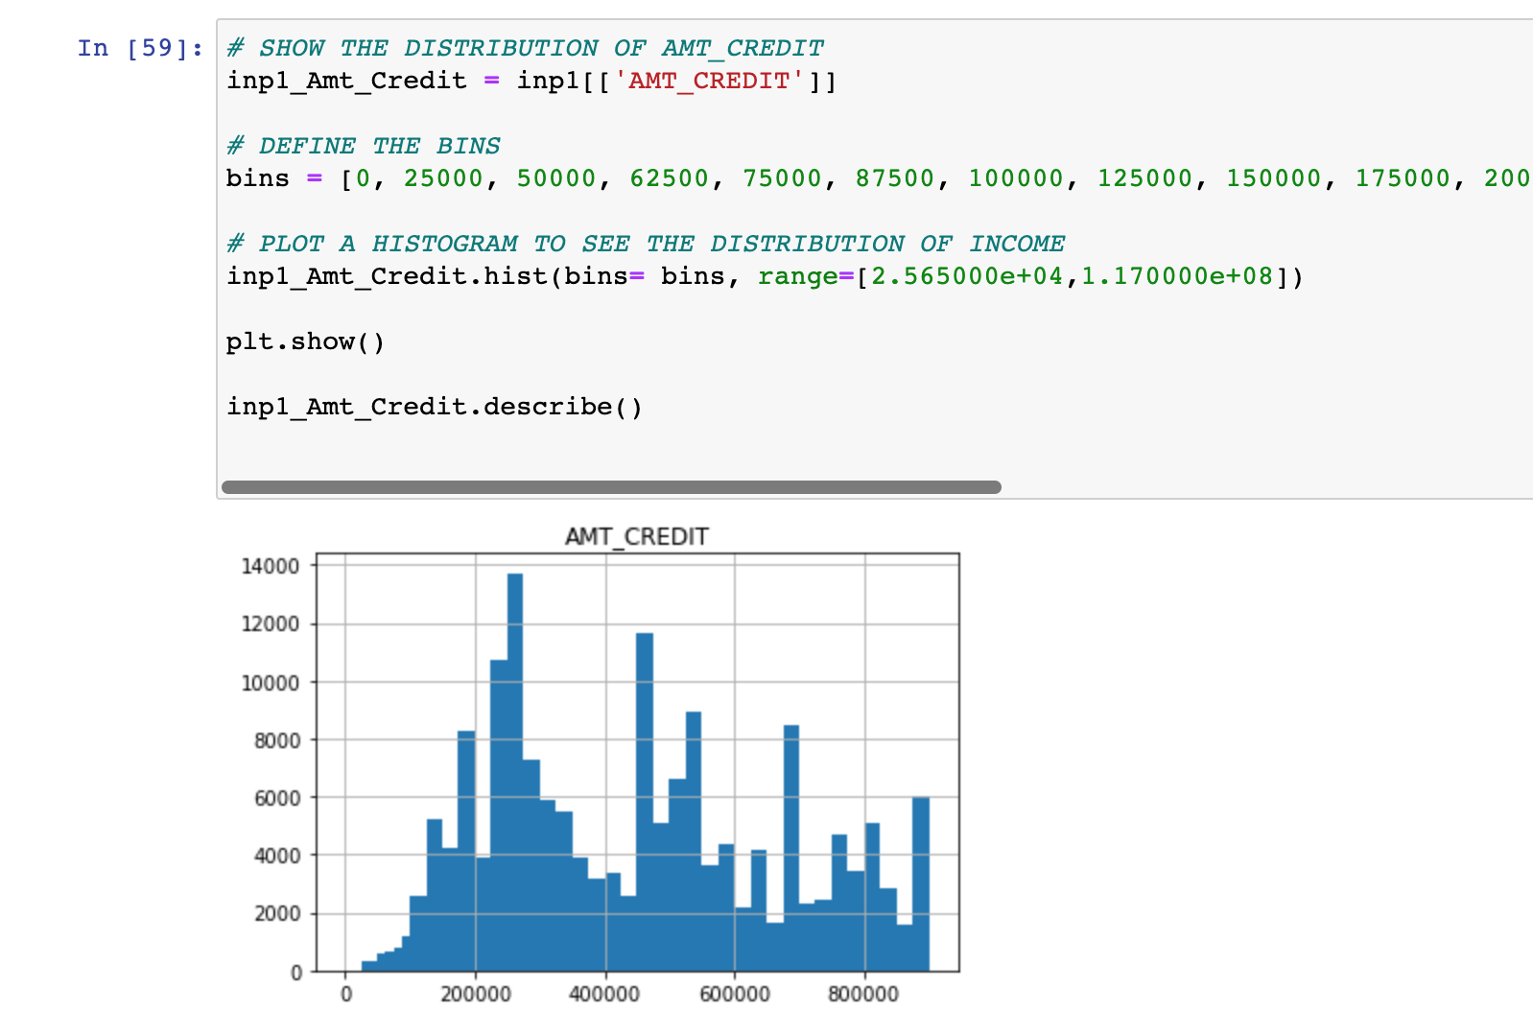
UNIVARIATE ANALYSIS

Slide 16
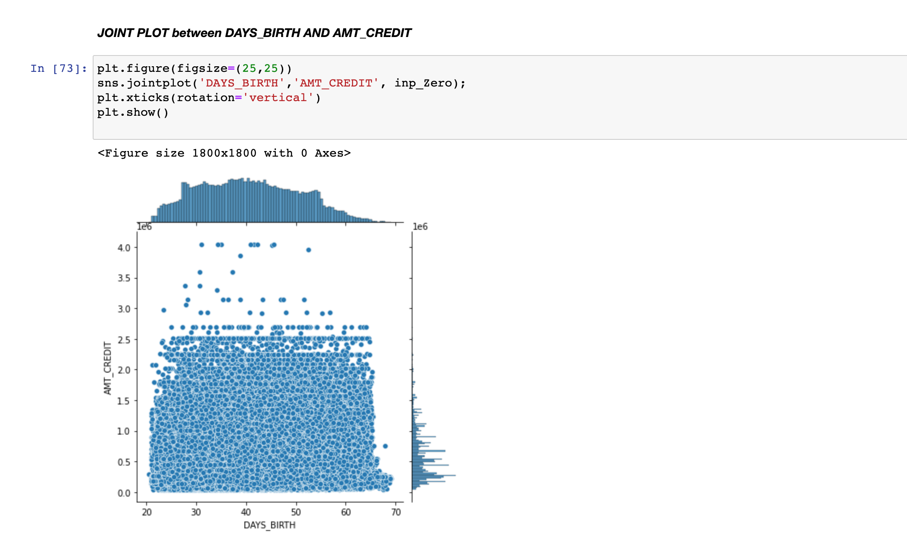
BIVARIATE ANALYSIS

Slide 17
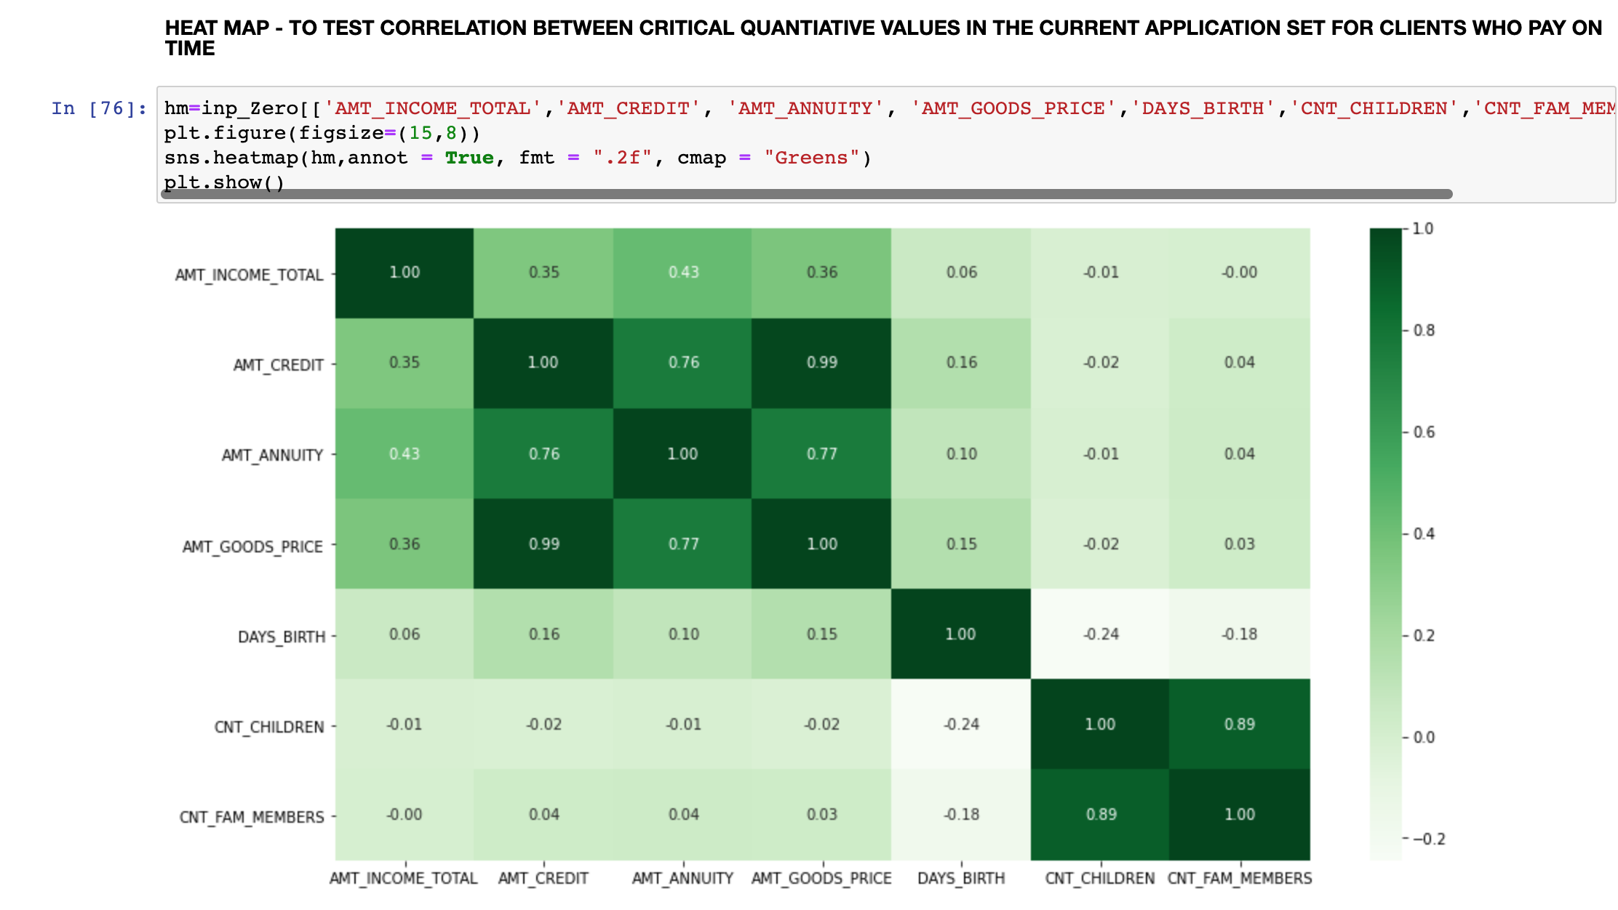
CORRELATION – HEATMAP ON WHO PAY ON TIME

Slide 18
DATA IMBALANCE
In Application_data dataset, 91.2% are non-defaulters and 8.79% are defaulters of the loan amount as per my analysis.
Segmentation is done on the basis of the TARGET variable, as non-defaulters and defaulters of loan.

Slide 19
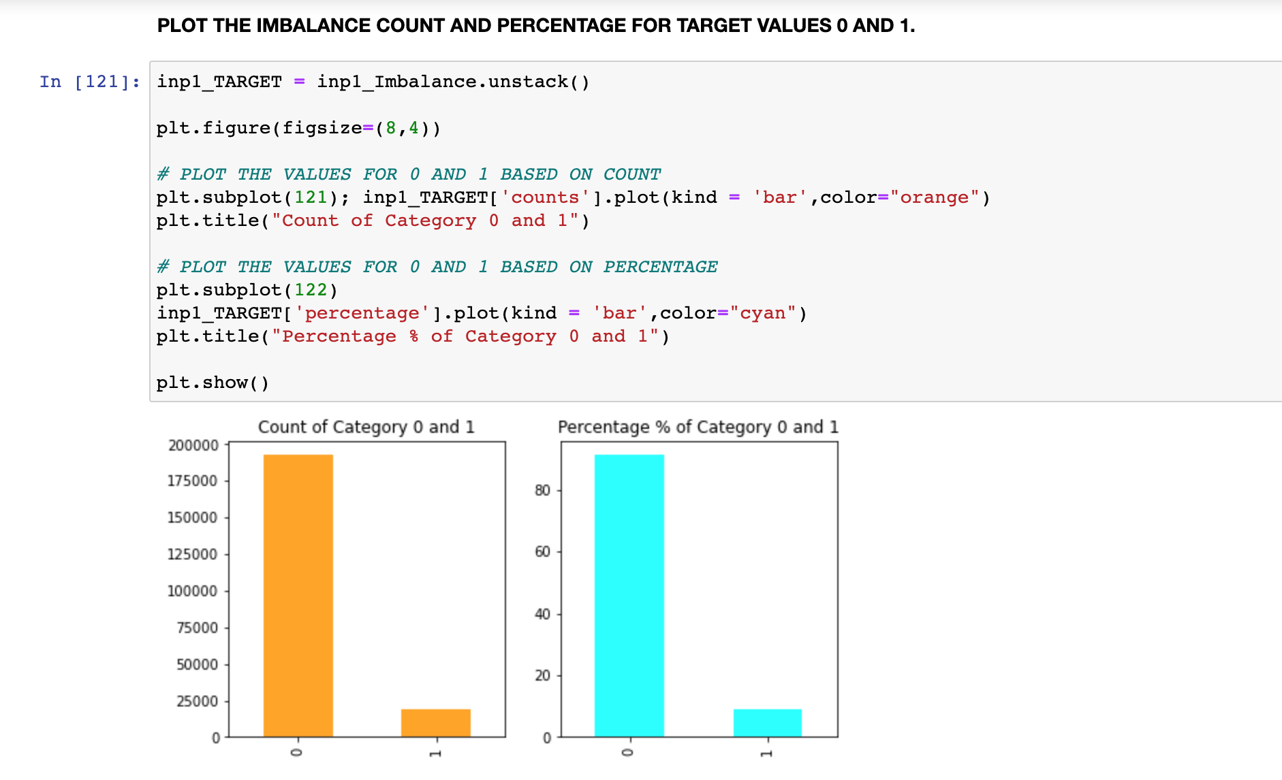
Data Imbalance BAR GRAPH

Slide 20
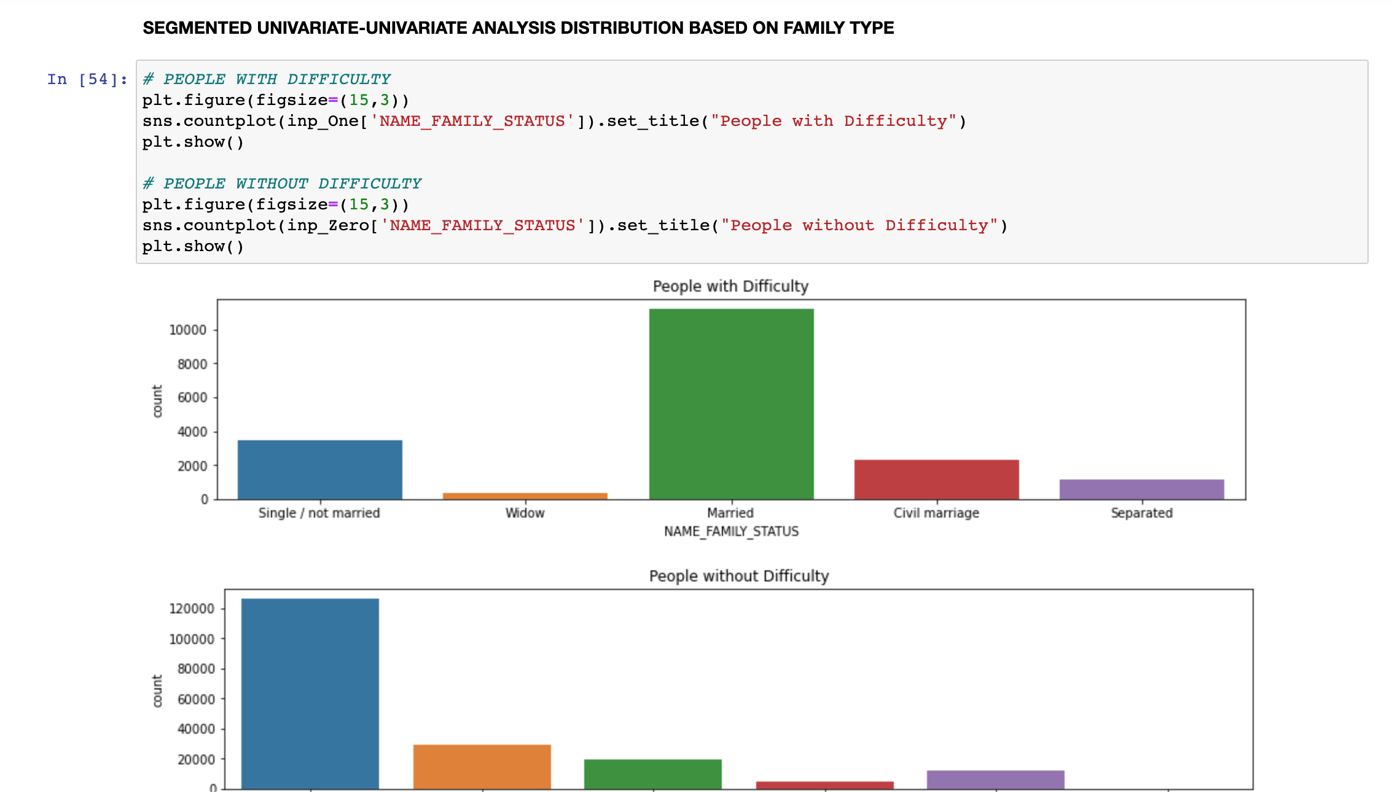
Segmented Univariate Analysis on FAMILY_STATUS

Slide 21
Previous_data Analysis
The SK_ID_CURR is the main focused column.
The shape of the dataset is 1670214,37.
The columns greater than 30% of missing values are dropped.
Outliers are identified and dropped.

Slide 22
Previous_data Analysis
Converted negative values present in the “Date”column into positive numbers.
Binning is done on the “DAYS_DECISION”.
Total count of missing values in the rows are also shown in the notebook.
Univariate analysis is done.
Bivariate analysis is done.
Correlation is shown using HEATMAPS.

Slide 23
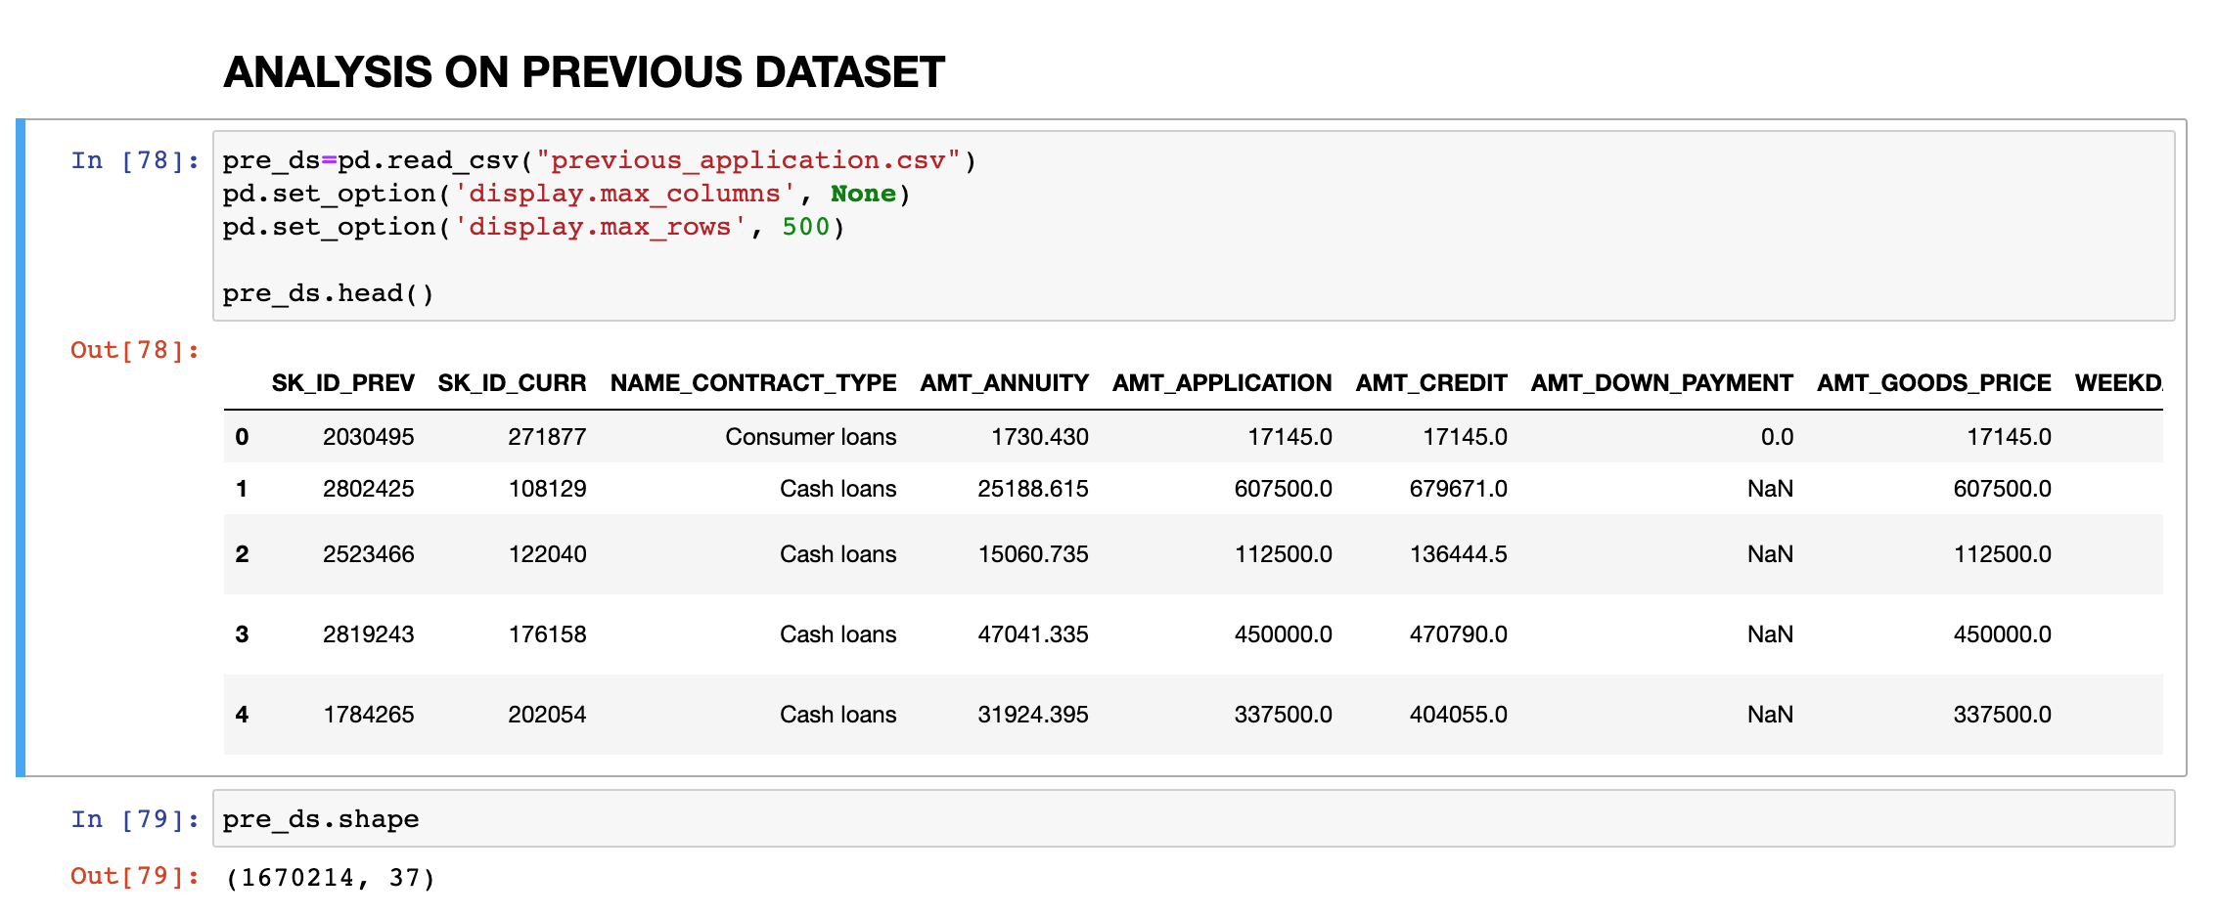
Previous_data Analysis

Slide 24
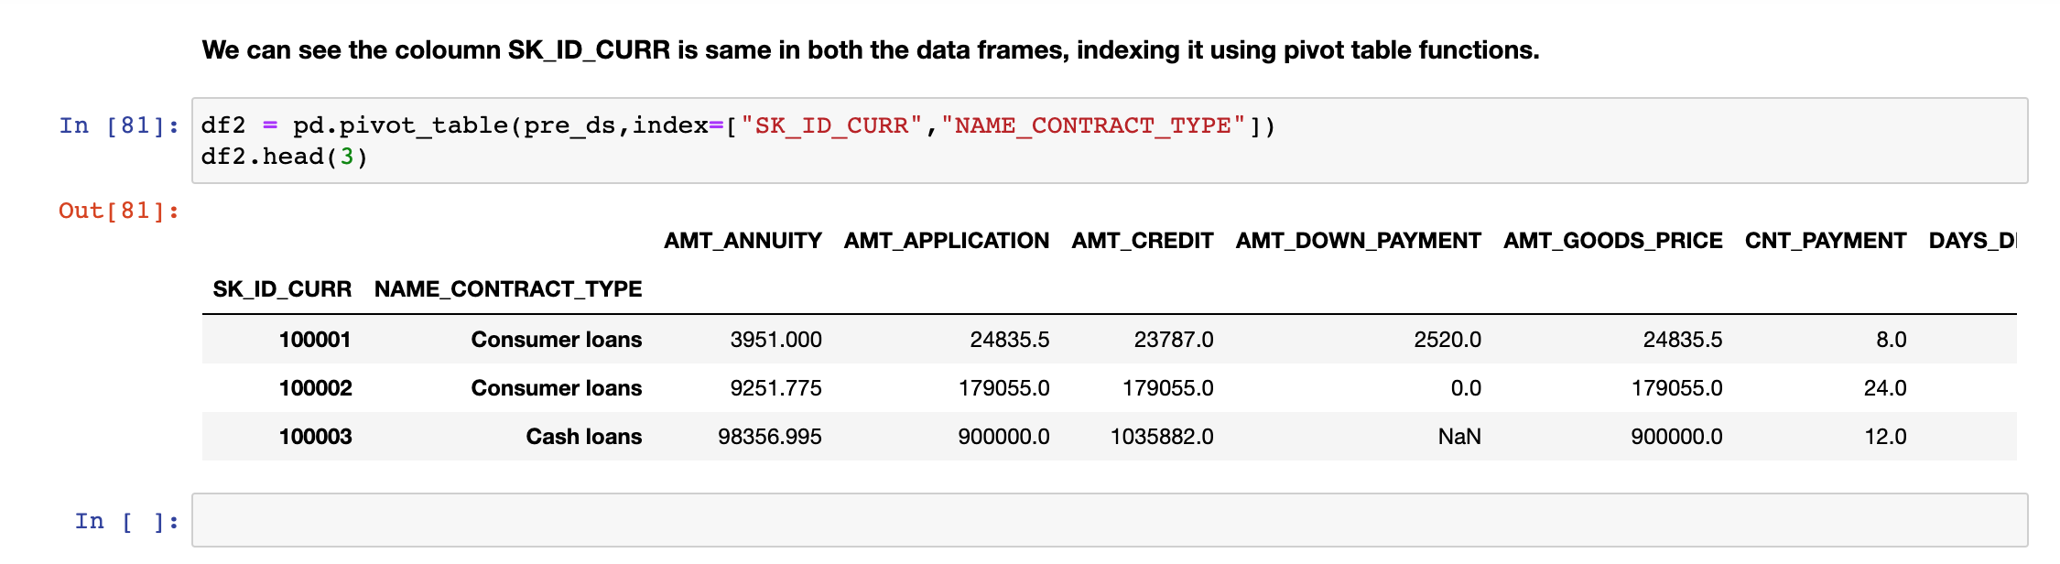
Merging on SK_ID_CURR

Slide 25
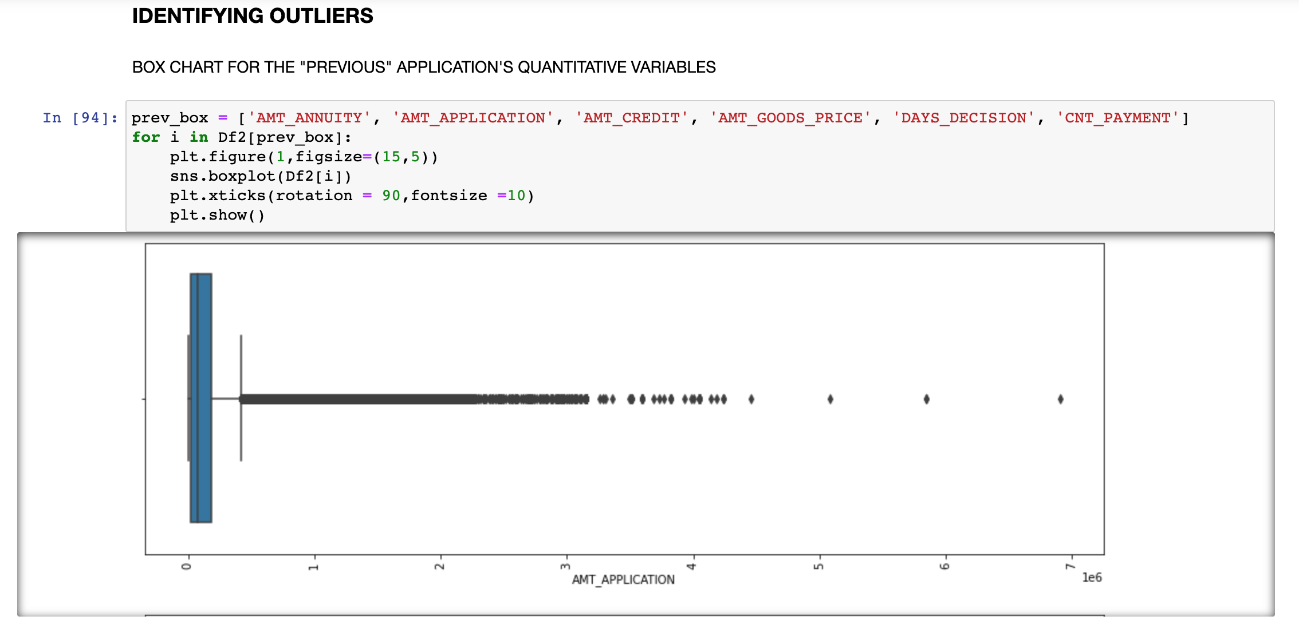
Identifying OUTLIERS

Slide 26
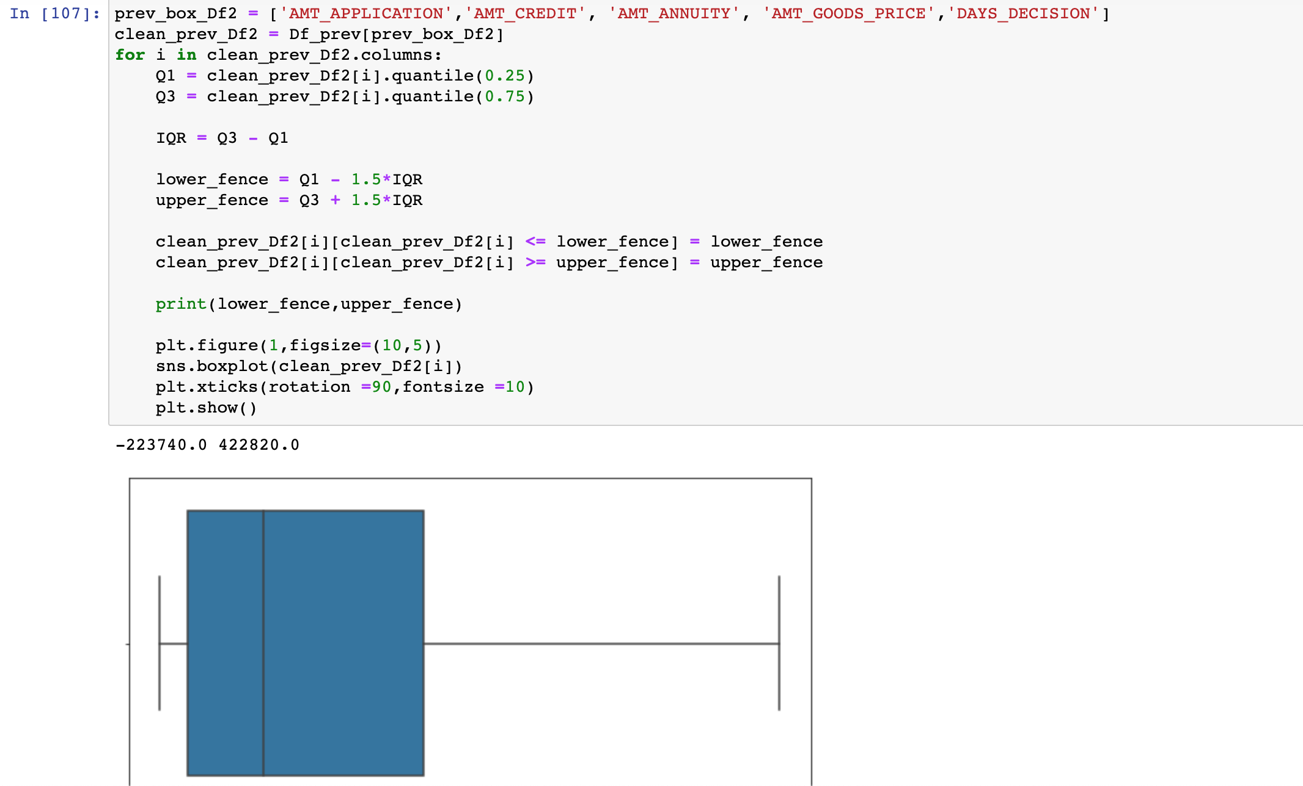
OUTLIERS TREATMENT

Slide 27
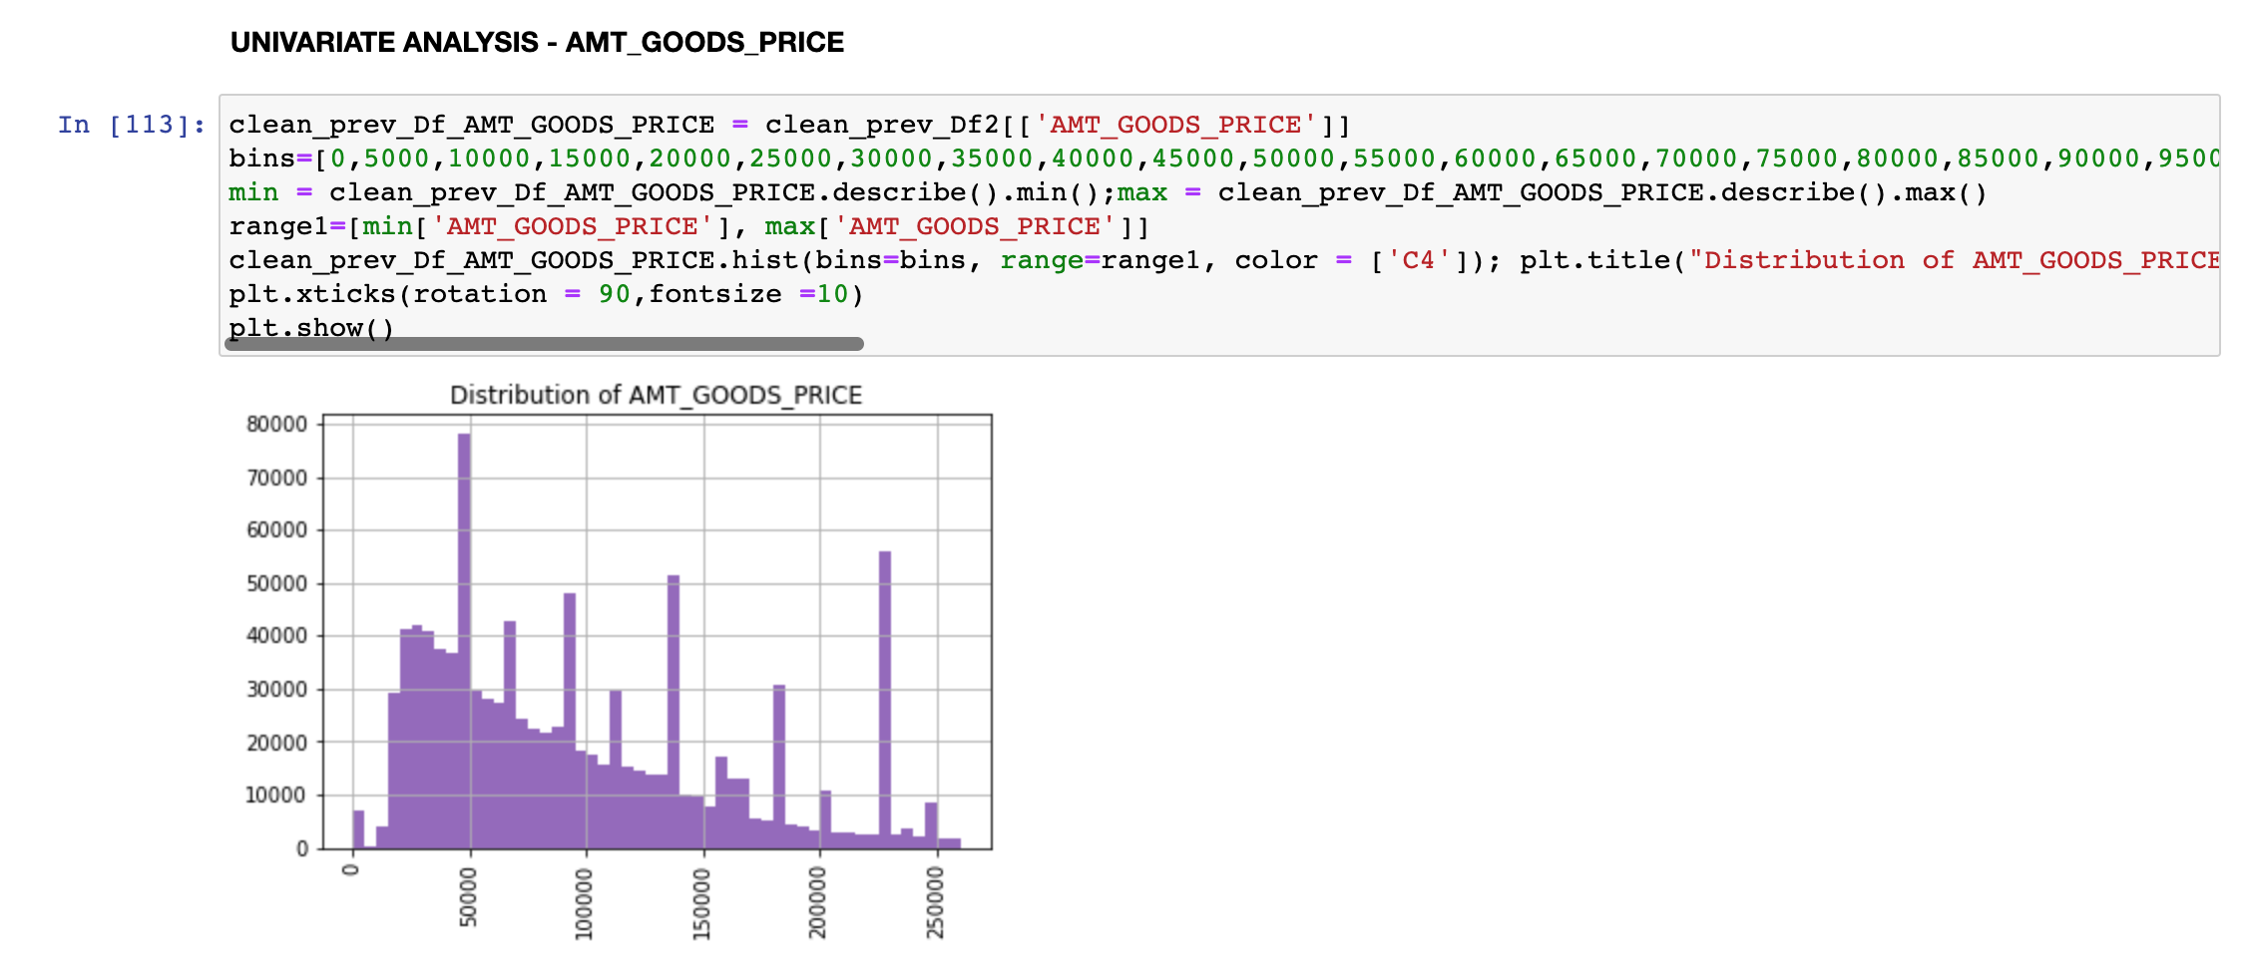
UNIVARIATE ANALYSIS

Slide 28
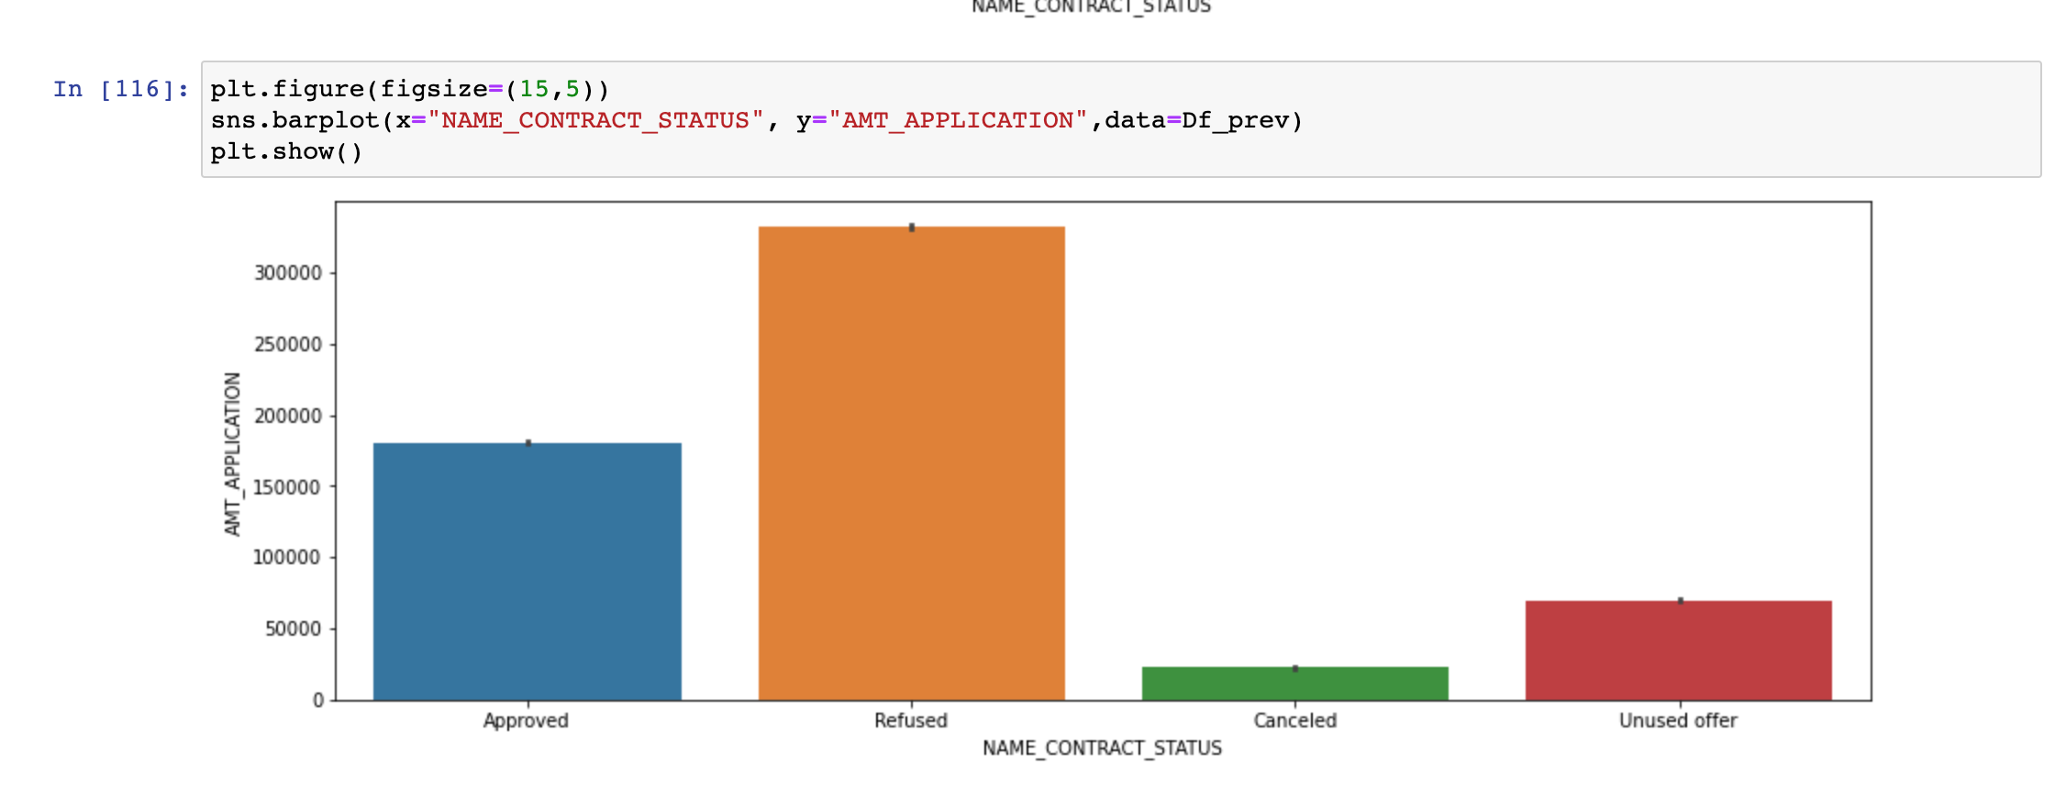
BIVARIATE ANALYSIS

Slide 29
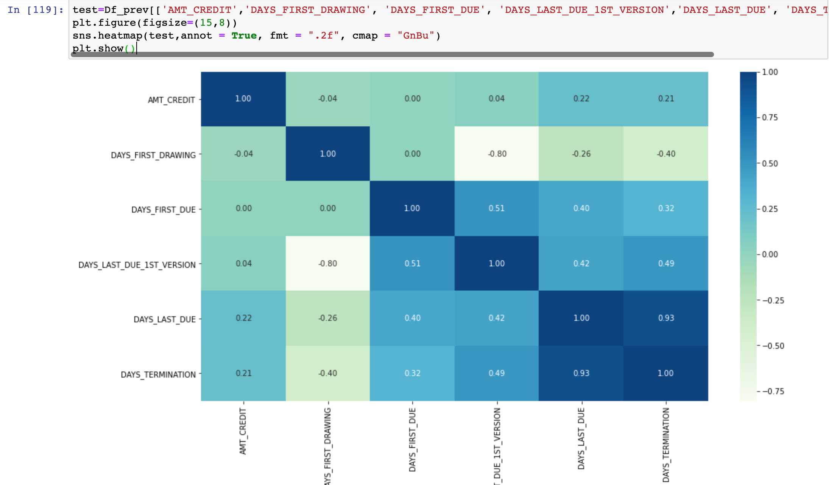
CORRELATION SHOWN USING HEATMAP

Slide 30
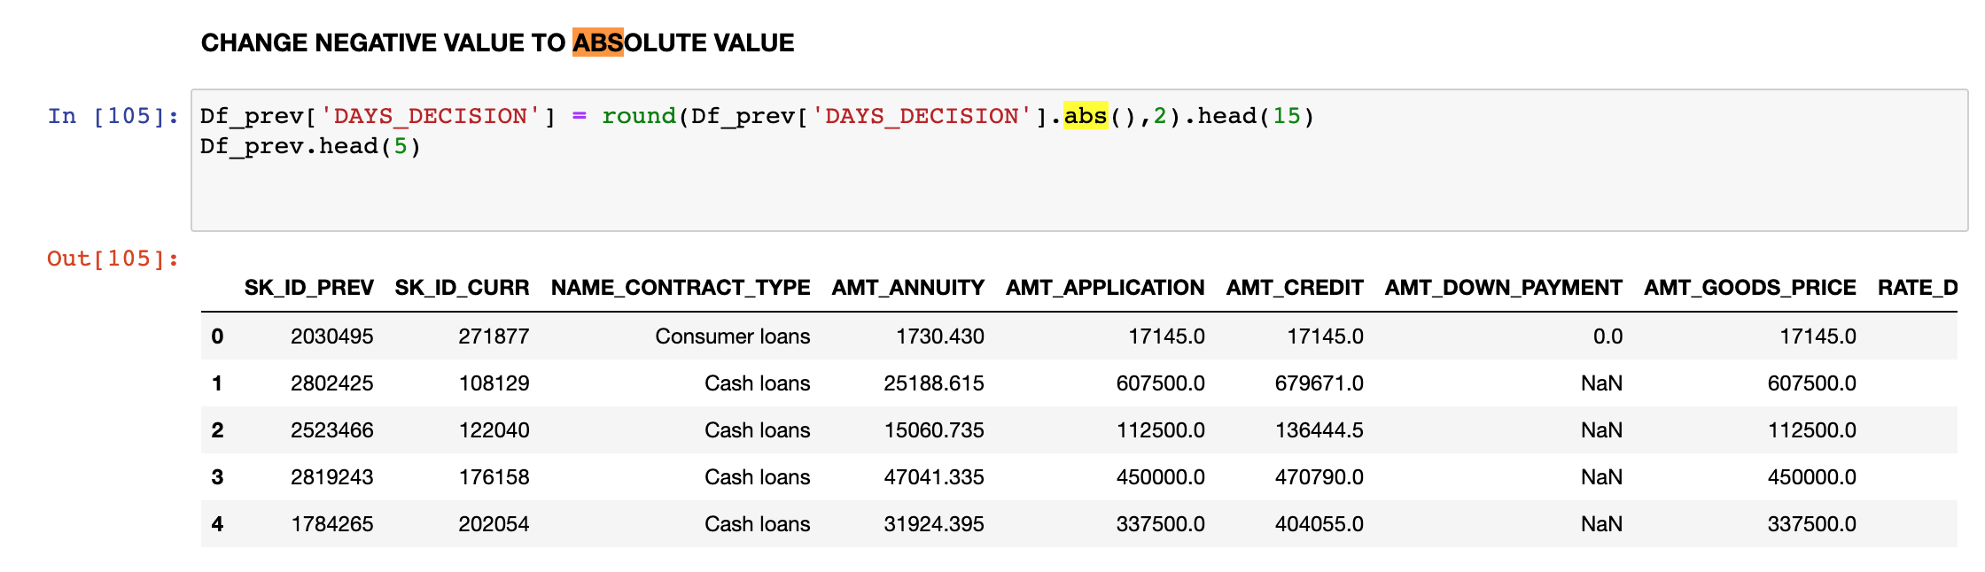
Conversion of Negative Numbers into Positive numbers in “DATE”

Slide 31
Observations on both the DATASETS
91.2 % are non-defaulters, 8.79% are defaulters of loan.
18.94% of loans have been cancelled by the customer.
The average age of Clients is around 44 years.
Most of the loan defaulters come in the income range of 112000 to 202000
Most of the defaulters loan amount is in the range of 285000 to 733000
Most of the defaulters loan Annuity is in the range of 24000 to 26000.

Slide 32
Observations on both the DATASETS
The loan amount sanctioned has a strong correlation with the AMT_GOODS_PRICE and AMT_ANNUITY
The first drawing, First due, Last Due and Last termination has "NO" bearing to the sanction loan amount.

